Slide 1
Student’s Name
Institution
CASE REPORT: SURGICAL EXTRACTION

Slide 2
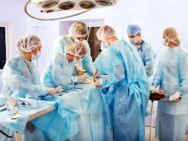
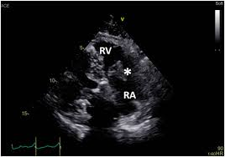
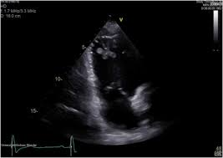
Outline
Introduction
Case report overview
Discussion
Pacemaker extraction
Conclusion

Slide 3
Test Questions
Multiple choice
What are the risks of open heart surgery?
    (a) Chest would infection (b) Heart attack (c) Blood loss (d) All of the above
What are the advantages of heart bypass surgery?
    (a) Reduced risk of stroke (b) minimized heart rhythm problems (c) None of the above
Which of the following tools is not found in cardiothoracis surgery?
    (a) cardiovascular clampps (b) Cardiovascular scissors (c) Hole saw

Slide 4
Test questions
True or False
      Blood test on patient is important before a cardiovascular surgery? (True or False)
Short answer
      Why do you think cardiac implantable electronic device (CIED) is increasing?

Slide 5
Introduction
Cardiac implantable electronic device continues to gain popularity
This is associated with the aging population
Threat of lead-related infective endocarditis (LRIE) becomes common
LRIE concerns include development of large intracardiac lead vegetation
Such vegetation can increase health risks
Notes:
As technological advancement in the medical field continues to expand, more risks are also emerging. The old or aging population are exposed to greater health risks including exposure to large intracardiac lead vegetation. ILV, as explained in this article can expose patients to more dangerous and risky cardiovascular conditions. Therefore, surgical procedures become the best option for patients with this condition to survive.

Slide 6
Continuation of Introduction
Surgical extraction is the best option
Cardiopulmonary bypass (CPB) can help patients with ILV
This case report explains the surgical extraction with CPB of an infected pacing system
The report shows:
A new epicardial pacemaker was reimplanted to minimize the risk of recurrent blood infection
Notes:
This report explains how CPB surgical procedure was used to surgically extract an infected pacing system in a haemodialysis patient with an enlarged ILV. The report shows that a new epicardial pacemaker was reimplanted to reduce the risk of recurrent blood transfusion.

Slide 7
Case report overview
Involved a 57-year old man
He as admitted with:
Intermittent Fever
Past medical history of dual-chamber pacemaker implanatation
40-years history of hemodialysis
Long-term steroid administration for systemic autoinflamatory disease
Notes:
The case report involved a 57-year old man who was admitted with intermitten fever and past history of dual-chamber pacemaker implantation. He had already been treated with atrioventricular block nine years before. He also had 40-years history of hemodialysis.

Slide 8
Blood cultures
Blood cultures was characterized by:
Positive methicillin-resistant
Coagulase-negative staphylococcus
Confirmation of S. epidemidis
White blood cell count was 18,000/ul
Elevated C-reactive protein of 16mg/dl
No signs of pocket infection noted
Notes:
After admission and the first observation carried out, the above blood culture characteristics were noted. This includes presence of methicillin resistant, coagulase-negative staphylococcus, and confirmation of S-epidermidis. Also, the physicians confirmed the white blood cell count as 18,000/ul.

Slide 9
Further observations
Echocardiography:
Giant and echogenic lobular mass
The mass estimated to be about 35X35mm
Located around the RV lead
It was large enough to occlude the tricuspid valve in diastole
Ejection fraction was at 57%
No signs of heart failure noted
Notes:
Echocardiography observation showed that there was a giant echogenic lobular mass located around the patient’s RV lead. The mass was large enough that it could occlude the tricuspid valve in diastole completely. Also, an ejection fraction rate of 58% was recorded. However, the patient showed no signs of heart failure

Slide 10
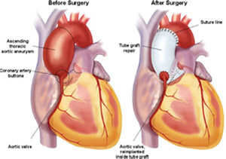
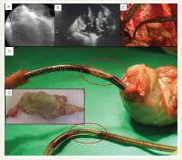
Discussion-Surgical Procedure
Urgent surgical extraction was performed
This type of surgery was appropriate because:
Transvenous extraction was risky
Due to interference from the suspected ILV
Notes:
Upon discovery of the mass, the patient was taken through an urgent extraction of the pacing system. This urgent surgical extraction was deemed appropriate since a transvenous extraction could not be employed due to the risks involved, especially in relation to interference from the suspected ILV.

Slide 11
Pacemaker extraction
Patient was put under general anesthesia
And, full sternotomy
CPB surgery was performed with ascending aortic and bicaval cannulation
Cardiac arrest was obtained
No severe adhesion was noted between intracardiac leads and innominate veins
Notes:
The procedure started with the patient subjected to a general anesthesia and full sternotomy. After which, a CPB surgery was performed with ascending aortic and bicaval cannulation. During the procedure, the surgical team obtained a cardiac arrest, but there seemed to be no serious adhesion between the intracardiac leads and innominate veins.

Slide 12
Surgical Process
The right atrium (RA) was opened
A 35X35mm ILV was located around the RV lead
However, pacing leads were normally located
No abnormal loop formation was noted
The giant ILV and tips successfully extracted
There was no injury to TV, RV, and RA walls
Pacemaker removed from right subclavian
Notes:
During the surgery, the right atrium was opened and 35X35mm ILV was identified located around the RV lead. The surgeons also noted that the leads were normally located and no abnormal loop formation was seen. As a result, the giant ILV was successfully removed without injury to TV, RV, and RA walls. Also, the pacemaker was removed from the right subclavian successfully.

Slide 13
Continuation of Surgical process
No lead abrasion was noted either
After the removal of the giant ILV, a new dual-chamber pacing system was reimplanted
Reimplantation involved two epicardial leads on the RA and RV
A new generator was positioned in the patient’s left hypochondrium
Both pacing and sensing thresholds were successful and acceptable
Notes:
During the operation, the doctors successfully removed the giant ILV and reimplanted a new dual-chamber pacing system successfully. After the reimplantation, it was noted that both pacing and sensing thresholds were acceptable and successfully implanted.

Slide 14
Postoperative hemodynamics
Postoperative hemodynamics was stable
Patient discharged from ICU after three days
Hemodialysis resumed after surgery day
Inflammatory findings improved after he surgery
VCM continued for more 6 weeks
GM terminated after five days
Patient transferred to regional hospital for rehabilitation
Notes:
The operation went on successfully and as postoperative findings show, the patient recovered successfully with great improvement. The patient, however, continued with the hemodialysis as before but GM was terminated while VCM continued for further six weeks.

Slide 15
Conclusion
This report presented surgical extraction under CPB surgery technique
The surgery was performed on a 57-year old man with an enlarged ILV
The operation went on successfully
ILV removed with a new dual-chamber pace making system implanted
The case, however, lacked most known factors for ILV
Notes:
This report showed a surgical procedure of a pacing system extraction through CPB surgical technique. No serious complications was recorded and the patient recovered successfully. The new pacemaker was implanted immediately to minimize blood infection risks associated with such pacemaker-dependent hemodialysis.

Slide 16
Reference
Nakajima, T., Kaminishi, Y., Kato, H., Gomi, S., Mathis, B. J., Hiramatsu, Y., & Sakamoto, H. (2019). Surgical extraction of a giant intracardiac lead vegetation and epicardial pacemaker reimplantation in a pacemaker‐dependent hemodialysis patient. Journal of cardiac surgery, 34(9), 877-879.

